Slide 1
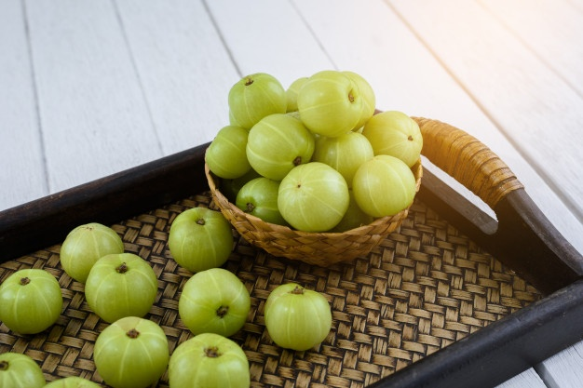
Global Market of Amla Hair Oil
Indian export Report

Slide 2
Contents
CHAPTER 1 EXECUTIVE SUMMARY
CHAPTER 2 HERBAL AMLA HAIR OIL- INDIAN EXPORT
Brand-wise Importing Countries of Amla Hair Oil
Brand-wise Importing Value of Amla Hair Oil
Brand-wise Top Markets
Top Countries As Per No. of Brands Imported

Slide 3
Continent Wise Total Number of Manufacturers
Europe is the major suppliers of Amla Herbal Hair Oil
Top Indian Brands (As per Value)
BONITA
PARACHUTE
PAMIR
SANA'S
DABUR
Brand-wise Top Markets
United Arab Emirates
United States
Australia
Germany
Mauritius
Top Markets (As per Value):
United Arab Emirates
Angola
Pakistan
Algeria
Saudi Arabia .
Most Imported Brand
DABUR
PARACHUTE
BRAHMI
EMAMI
BAJAJ
All details available in embedded excel sheet

